Slide 1
Ranking Hospital Performance
Brining Consumerism to Healthcare
June 5th, 2019
Presenters: Marin Gow, Michael Diarra, Venku Buragadda, Zain Iqbal & Zain Jafri

Slide 2

Agenda (Update to be a different format and align with our final deck)
Introduction & Problem (Zain J.)
01
Data Overview & Exploration (Venku)
02
Data Preparation and Feature extraction (Marin)
03
Evaluation of each model (Michael)
04
Challenges ,Recommendations & Future improvement (Zain I.)
05

Slide 3





Consumerism Is Everywhere
In nearly every industry and sector, consumer power has grown in the last 10 years as the availability of data has given consumers previously unknown levels of transparency into the quality of goods and services provided.

Slide 4
Except for the Healthcare Industry
The healthcare industry significantly lags other industries when it comes to expanding the power of consumers through technology – with a major driver being a lack of timely data on the quality and performance of healthcare providers (among other things).
The Centers for Medicare & Medicare Services (CMS) operates several programs measuring the quality and performance of healthcare providers; however:
Data collection and reporting is not timely – often lagging 1-2 years (confirm)
Reporting is not easy for consumers to access and interpret
Traditional healthcare providers and insurers often do not have an incentive to provide greater transparency to consumers

Slide 5
Problem Statement
Based on one year of data (2017), what insights can be derived to benefit:
1. Consumers / riders?
2. The city of Chicago?
3. The provider (CDOT)?

Slide 6
Model Problem Statement
Add some sort of graphical representation or output

Slide 7
Data Overview & Exploration
Will we need a second slide for the imputation? Could be a good way for us to call out our methodology.

Slide 8
Selected Datasets
Center for Medicare Services
Data source
CMS is the government body that runs Medicare and Medicaid and audits the performance of U.S. hospitals and healthcare organizations.
Target Variables
Star Rating
Complications and Deaths
Dataset - predictors
Dataset of various types of complications and deaths that have occurred at each U.S. hospital, expressed as count per thousand. Examples include bedsores and deaths from complications post surgery.
Recommended Linear Score
Patient Survey Scores
Dataset – predictors and target
87
Dataset of survey scores received by hospitals from patients. Survey covers topics such as cleanliness and nurse communication.

Slide 9
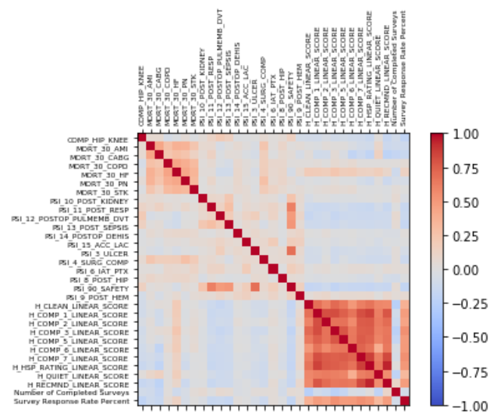
Data Preparation
Unpivoted survey data
Combined datasets using shared Provider ID
Dropped high cardinality features such as zip code

Slide 10
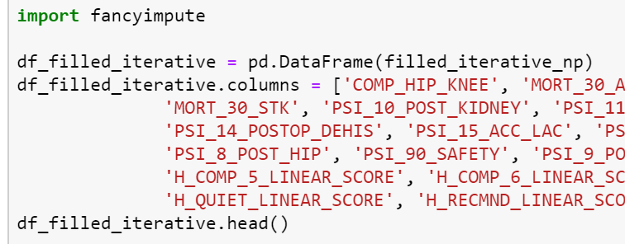
Imputation
Three imputation methods:
Mean
Linear regression
KNN
Linear regression performed best across most of our models

Slide 11
Modeling Approaches Utilized: Regression
We tested several modeling approaches, however ultimately landed on [Model X] due to….
 | Model 1 | Model 2 | Model 3 | Model 4
Overview
Performance | Accuracy Precision Recall F1 Score RMSE

Slide 12
Modeling Approaches Utilized: Classification
We tested several modeling approaches, however ultimately landed on [Model X] due to….
 | Model 1 | Model 2 | Model 3 | Model 4
Overview
Features
Parameters
Performance | Accuracy Precision Recall F1 Score RMSE

Slide 13
Selected Model
We tested several modeling approaches, however ultimately landed on [Model X] due to….

Slide 14
Feature Refinement & Final Model
I am assuming similar to the homework we may run initial models and then refine the features; in which case we may want this slide. However, if not, we can delete.

Slide 15
Model Outcomes
A timely hospital quality and performance reporting application for consumers
Based on consumer surveys and voluntary reporting from hospitals
Reports an overall score and ranking for each hospitals in a region
Used by consumers to determine where they may seek non-emergency care
For this slide, I think we should take the outputs of the model and pick a region/geography to do a deep dive on the results and what the application would be. E.g., rank hospitals in Chicago to show how they perform relative to one another.
I could also foresee this being multiple slides of graphical outputs, similar to the example we looked at. We probably need to further discuss/think more about what these would be.

Slide 16
Recommendations
Recommendations on how to use the model, improve it, etc.

Slide 17
Challenges & Limitations

Slide 18
References
Reference 1
Reference 2

